Slide 1

Sagar Institute of research and Technology
Department of Artificial Intelligence And Machine Learning
Expression of Interest
BT – 107
Submitted To: Submitted by:
Mrs.Shweta Biley Shubham Rahangdale
Department of AIML Roll No. 0133CL221100

Slide 2



HR Hiring System Using Expert System
An innovative HR hiring system utilizing expert system technology to revolutionize the recruitment process, ensuring efficient and effective candidate selection.
by shubham hacktechworld

Slide 3

Introduction to HR Hiring System
Understanding the challenges faced by HR departments in traditional hiring processes and the need for a modern solution.

Slide 4

Explanation of Expert System Technology
Exploring the underlying principles and capabilities of expert systems and their relevance in HR hiring.

Slide 5

Benefits of Using an Expert System for Hiring
1
Enhanced Efficiency
2
Improved Accuracy
Streamlined candidate screening, assessment, and selection processes resulting in time and cost savings.
Reduced human bias and errors through objective analysis and data-driven decision-making.
3
Consistent Evaluation
Standardized evaluation criteria ensuring fairness and equal opportunities for all applicants.

Slide 6
Key Features of Our HR Hiring System
Intelligent Screening
Evaluation Analytics
AI-driven Interviews
Automated assessment of resumes and application details to shortlist the most qualified candidates.
Comprehensive data analytics and reporting to track hiring performance and optimize the recruitment strategy.
Utilization of artificial intelligence for conducting automated video interviews with customizable question sets.

Slide 7


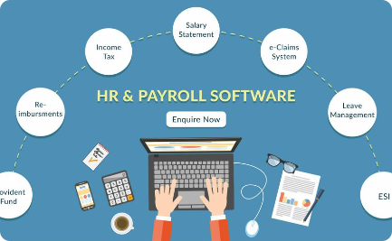
Real-World Examples of Our System in Action
Company A
Company B
Company C
Increased efficiency by 30% and reduced time-to-hire by implementing our HR hiring system.
Improved candidate quality and minimized human bias leading to better organizational performance.
Enhanced candidate experience and optimized recruitment process resulting in higher satisfaction rates.

Slide 8

Integration with Existing HR Infrastructure
Seamless integration with HRIS systems, ATS platforms, and other HR tools to ensure compatibility and maximize productivity.

Slide 9
Conclusion and Next Steps
Summarizing the benefits of our HR hiring system and outlining the next steps for organizations interested in adopting this cutting-edge technology.

Slide 10
Thank You

